Slide 1
Creating Accessible Presentations: Features and Tools
March 23, 2023
Megan Sellmer, Melody Shih, and Tobe Duggan

Slide 2
Land Acknowledgment
“Our presenters today come from across this land, living and working in what we now know as Canada. We respect and affirm the inherent and Treaty Rights of all Indigenous Peoples and will continue to honour the commitments to self-determination and sovereignty we have made to Indigenous Nations and Peoples. We respectfully ask for you all to take a moment to acknowledge the lands on which you reside.”
Notes:
I would like to begin with a land acknowledgment that…

Slide 3
Tables
If you must use tables, keep them simple.
Mark up the header row.
Don’t use a fixed layout.
Don’t merge cells.
Don’t have blank cells.
Use the largest text possible and a sans-serif font.
Notes:
Describe the tables

Slide 4
Transitions and Animations
Avoid using elaborate transitions and automation.
They don’t communicate anything important in the presentation.
They can be distracting and make some viewers sick.
In some cases, animation can help viewers focus on the discussed text.
This especially helps when there is too much text on the slide.
Notes:
Searching for an accessible presentation in PowerPoint means that the template is tagged with that term. It doesn’t guarantee that it is accessible
We recommend having less text on the slide.

Slide 5
Drawings and Annotations
Avoid using drawings, both in creating your slides and during your presentation.
These are inaccessible and often difficult to see, especially when done during the presentation.
Depending on their creation, they may use only colour to convey meaning.
Add alt-text descriptions if you use them, which we will discuss next week.

Slide 6
Captions and Subtitles
Google Slide and PowerPoint let you add captions/subtitles to your presentations.
When presenting in a room of people, use the captions in Google Slides or PowerPoint.
If possible, provide an American Sign Language (ASL) interpreter.
We recommend that you edit the captions before posting your presentation recording.

Slide 7
PowerPoint: Enabling Subtitles and Captions
How to turn on captions in PowerPoint:
Begin the slide show and click on the ”CC” icon on the bottom left of the screen.
You can adjust the subtitle settings under the “Slide Show” option in the PowerPoint toolbar.
Notes:
Adjusting the settings in PowerPoint: selecting the language, location of the subtitles, how they visually appear, etc.)
Google Slide captions are only available in English.

Slide 8
Google Slides: Enabling Subtitles and Captions
How to turn on captions in Google Slides:
Begin the slide show and click on the more options (three vertical dots) at the bottom left side of the screen.
Select “Captions Preferences” and choose “Toggle captions.”
Or use “Ctrl + F5” (on Windows) or “Command + Shift + C” (on Mac).

Slide 9
Notes and Comments
If using notes in PowerPoint, Keynote, and Google Slides.
Use a large text size.
Use a sans serif font.
Consider the colour contrast between the text and background.
Comments can be accessible, but avoid them if unnecessary.
Notes:
The PowerPoint and Google Slides background is light grey; the Keynote background is white.
Comments are accessed using different keyboard screen reader commands for each presentation program.
Comments use very small print that needs to be magnified.
When exporting your slides into another type of format (e.g., PDF), the comments and notes are not accessible – either they are not exported or they are not accessed by screen readers.

Slide 10
Accessible Handouts
Create accessible handouts for your presentation.
Options include: HTML, PDF, DOC, and PPT
Unless properly marked up, PDFs are not accessible.
When I created the PDF version of this presentation, the reading order was improperly organized, and the items were improperly tagged.
Notes:
An HTML version is the most accessible.
Creating Accessible PDFs is an entire webinar series of itself.
For example, to create a more accessible PDF, I needed to reorder the reading order by moving items around in the list.In one case….give example.
Additionally, the lists in this presentation, for example, were tagged as paragraphs, and I needed to go in and change them to lists.

Slide 11
Creating an HTML Version of Your Slides
You cannot create an HTML document directly from PowerPoint.
Export the presentation in Rich Text Format (RTF) and open it in your preferred Word Processor (reformatting may be required).
Save as “Web Page” or HTML option.
In Google Slides, you can publish your slides to the web.
Select “File” > “Share” > “Publish to the Web” > ”Embed Link”
In Keynote, you can export your slides as HTML.
Select “File” > “Export To” > “HTML” > click on ”Next” > “Save”

Slide 12
PowerPoint Accessibility Checker
PowerPoint provides an Accessibility Checker for your presentation.
Click “Review” in the toolbar and select “Check Accessibility.”
The Accessibility Checker does not catch everything.
What it checks for:
Errors
Warnings
Tips
Notes:
Errors, like missing alt text, images that are not inline, missing slide titles, etc.
Warnings, like simple tables, insufficient colour contrast, and captions, are included in the media, and the reading order of the slides is correct.
Tips, like slide titles, which need to be unique and marked up as headings.
We’ve already talked about adding titles to slides, having sufficient colour contrast, creating simple tables and marking up your table header. We’ll discuss adding alt text and captions to your presentation next week.
Accessibility Checker is a great starting point!

Slide 13
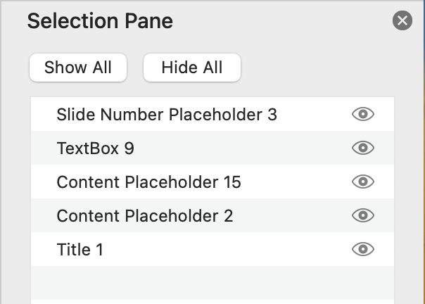
Slide Reading Order
Each element of a slide is one item.
The items are organized into a specific reading order.
As you edit a slide, the reading order can change.
The reading order of this slide.
Notes:
So let’s look at how to ensure the reading order of slides is correct.
For example, this page has a title, text box, image, and slide number, and that is the reading order they should be in.

Slide 14
How to Edit the Slide Reading Order
In PowerPoint:
From the ”Home” toolbar, click on “Drawing” > “Arrange” > “Selection Pane.”
In Google Slides
Select an item and choose > “Arrange” > “Order” > an option (e.g., “Bring to front”).
In Keynote:
Click on “Arrange” in the top menu or right side toolbar > choose an option (e.g. send backwards).
Notes:
You need to manually check the slide reading order in Google Slides and Keynote. Click on the top-left item and tab through the slide elements. The order the text boxes are highlighted is the reading order.

Slide 15
Demonstration: Person with Low Vision
Now a demonstration by Tobe!

Slide 16
Demonstration: Screen Reader User
Now a demonstration by Melody!

Slide 17
Thank You!
Thank you for attending the second webinar in the “Creating Accessible Presentations” series.
The next webinar is ”Images, Videos, and Graphics” on March 30, 2023, at 2:00 pm EST/11:00 pm PST.
Questions?

Slide 18
References
WAI Making Events Accessible: Checklist for meetings, conferences, training, and presentations that are remote/virtual, in-person, or hybrid: www.w3.org/WAI/teach-advocate/accessible-presentations/.
WebAim Accessible PowerPoint Presentation: https://webaim.org/techniques/powerpoint/.
Microsoft: Make your PowerPoint presentations accessible to people with disabilities: https://support.microsoft.com/en-us/office/make-your-powerpoint-presentations-accessible-to-people-with-disabilities-6f7772b2-2f33-4bd2-8ca7-dae3b2b3ef25.
Create accessible documents, spreadsheets, or presentations with Pages, Numbers, or Keynote: https://support.apple.com/en-us/HT210563.
Google Docs: Make your document or presentation more accessible: https://support.google.com/docs/answer/6199477?hl=en.

Slide 19
References Continued…
Presenter Toolkit by Rebecca Shortt: https://opentextbc.ca/presentertoolkit/chapter/presenting-practices/
Virtual Presentation Accessibility Guidelines by the America Anthropological Association: www.americananthro.org/VirtualPresentations?navItemNumber=25891

