Slide 1
Creating Accessible Presentations: Images, Graphics, and Videos
March 30, 2023
Megan Sellmer, Melody Shih, and Tobe Duggan

Slide 2
Land Acknowledgment
“Our presenters today come from across this land, living and working in what we now know as Canada. We respect and affirm the inherent and Treaty Rights of all Indigenous Peoples and will continue to honour the commitments to self-determination and sovereignty we have made to Indigenous Nations and Peoples. We respectfully ask for you all to take a moment to acknowledge the lands on which you reside.”
Notes:
I would like to begin with a land acknowledgment that…

Slide 3
General Considerations when Using Media in Presentations
Good quality media
High resolution
Large font size
Sans serif font
Good colour contrast

Slide 4
Images, Charts and Tables
Notes:
We recommend having less text on the slide.

Slide 5
Describing Images, Charts, Graphs, Maps, and Tables
If your presentation has images (simple and complex), you must add alternative text (alt text).
Alt text is a textual description of an image for people who can’t see the image (blind/deafblind).
Screen readers will read an image’s alt text if it is available.

Slide 6
Why Add Alternative Text
If alt text is not added, screen reader users will be excluded from accessing the full meaning of your images.
If you do not add alt text to your images, screen readers may read:
Auto-generated alt text
The image’s file name.
Nothing at all.
Notes:
Auto-generated alt text can be, at best, undescriptive and, at worst incorrect and confusing. For example, “may be a picture of indoor” is auto-generated alt text for a photograph of a library interior.
When screen readers read nothing, they only tell the user there is an “image” or a “graphic” with no label.

Slide 7
Creating Alternative Text
Do not include the phrase “This is an image/graphic of…” in your alt text.
Screen readers will announce that it is graphic.
If there is text within an image, write it in the alt text.
Your alt text should not include information available in the surrounding text.
Write for your audience.
Use present tense and action verbs.
Notes:
What we mean by not including surrounding information in the alt text is don’t add the cation text, for example, as that will just be repeated.
When writing for your audience, you will describe an image intended for children (like an image from a storybook) differently than you would a Stephen King book cover.
Additionally, do not use alt text to add extra information unrelated to the image, such as keywords.

Slide 8
Creating Alternative Text: Inclusive Descriptions
Use inclusive language in your descriptions.
Describe the physical characteristics of people in images.
Descriptions should be objective and free from censorship.
People who use screen readers should receive equal access to the information conveyed in images.
Notes:
For example, avoid gendering a person unless you know the pronouns they prefer.
Physical characteristics include hairstyle, skin tone, facial features, clothing, etc.
For skin colour, we recommend using the emoji scale: Light Skin Tone, Medium Skin Tone, Dark Skin Tone etc.

Slide 9
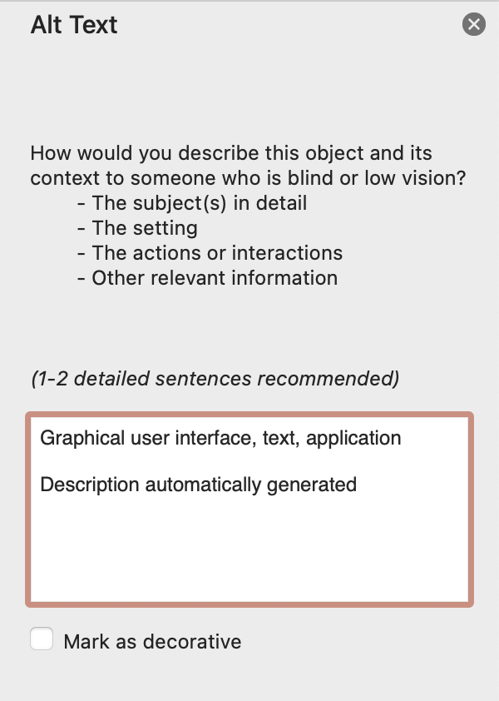
PowerPoint: Describing Images, Charts, Graphs, Maps, and Tables
Right-click on the image or graphic.
Select “View Alt Text”
A text box pops up on the right side of the window.
Edit or add the alt text.
Notes:
Note: PowerPoint provides auto-generated alt text, but it is often incorrect or not descriptive.

Slide 10
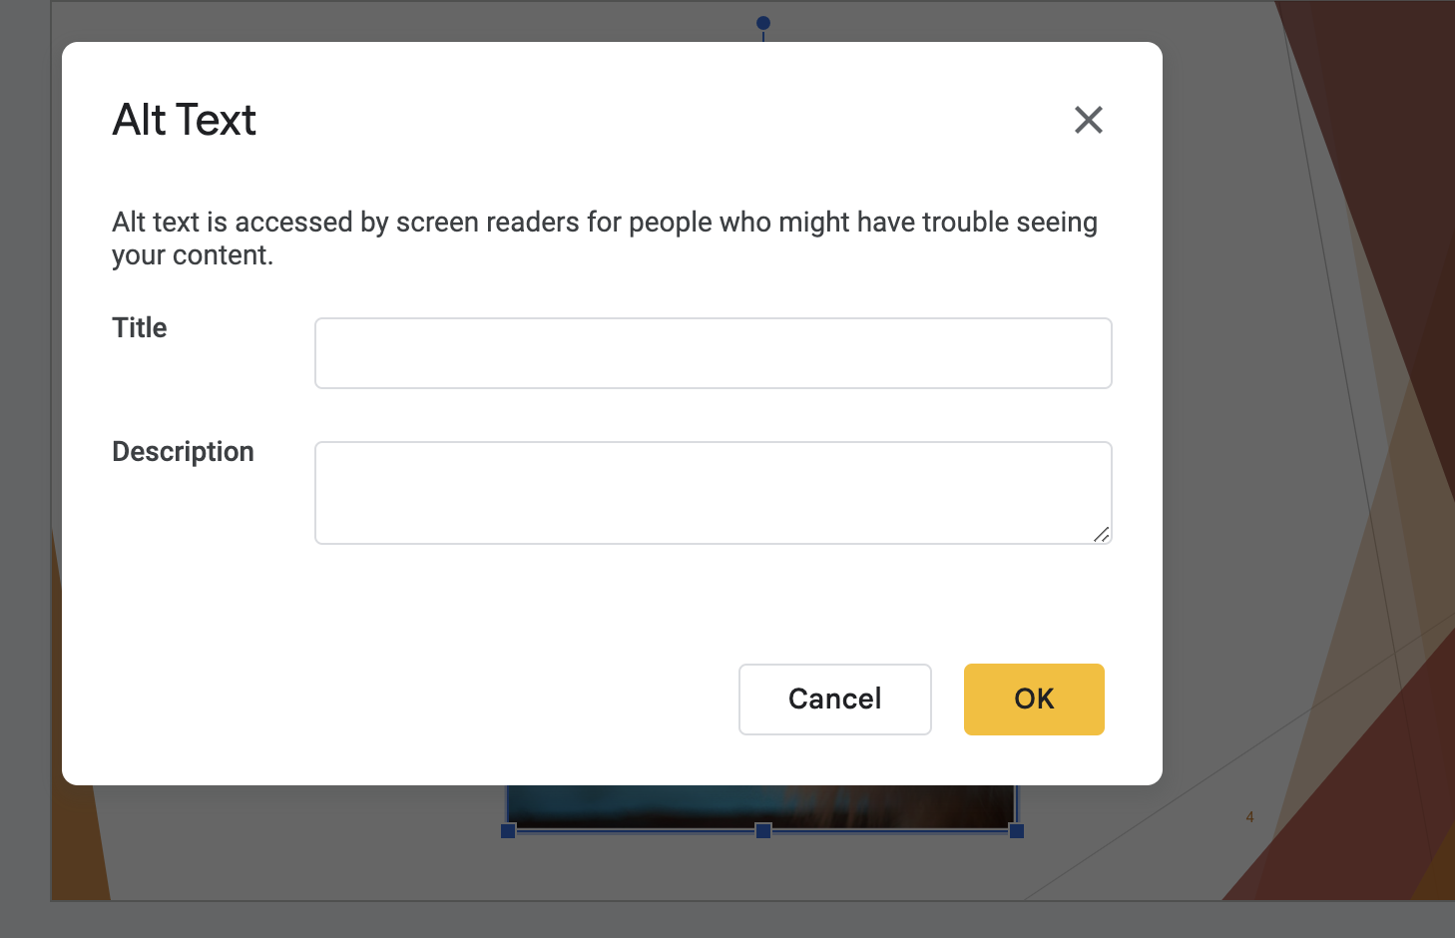
Google Slides: Describing Images, Charts, Graphs, Maps, and Tables
Right-click on the image.
Select “Alt text” from the drop-down menu.
A popup appears.
Add the title and description for the image.
Notes:
Keyboard shortcuts:
Ctrl + Alt + Y (Windows)
Command + Option + Y (Mac)

Slide 11
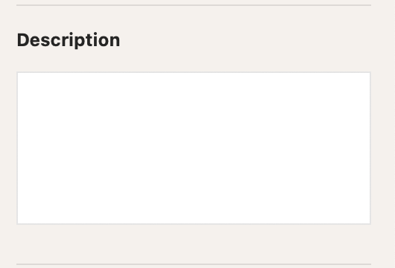
Keynote: Describing Images
Click on the image.
On the right toolbar, select the “Image” tab.
Add the description

Slide 12
Describing Complex Images
If your presentation has complex images you need to include longer descriptions.
A complex image includes:
Graphs
Tables
Infographics
Maps

Slide 13
What are Long Descriptions
A Long Description is a detailed text description of an image that can be several paragraphs long.
They describe all the information readers need to know to understand complex images.
Long descriptions are used in conjunction with alt text.
Add a link to the long descriptions, using informative hyperlinks, in your presentation.
They should be included in the supporting documents.
Notes:
For example, in a chart, you would describe the text like the y and x-axis labels, the percentages of the each option, etc.

Slide 14
Creating Long Descriptions
Write descriptions with a clear structure, working from the general to the specific:
Describe the overall image.
Break the image up into chunks of content and describe each separately in a logical order.
You should repeat the alt text in the long description to refer back to the image used in your presentation.
Follow the tips for creating alt text above.
Notes:
Long descriptions should provide an overview of the image before you describe specific details. You can break the image up into different parts and describe each individually. For example, in an infographic, describe each chart, table, image, etc., separately in a logical order like left to right.

Slide 15
Captions, Audio Descriptions, and Transcripts
Notes:
Errors, like missing alt text, images that are not inline, missing slide titles, etc.
Warnings, like simple tables, insufficient colour contrast, and captions, are included in the media, and the reading order of the slides is correct.
Tips, like slide titles, which need to be unique and marked up as headings.
Accessibility Checker is a great starting point!

Slide 16
Captions/Subtitles
Captions/subtitles are a text version of the audio users need to understand the content.
It includes:
The speech in the audio.
The background noise and sound effects.
Captions/subtitles created by programs and not a person should always be edited.
Notes:
What is being spoken in the video includes character dialogues and narration.
The background noise and sound effects can include things like birds chirping, or a door slamming.

Slide 17
Creating/Adding Subtitles in YouTube
On YouTube, select “Upload videos” to add your recording.
Once YouTube has processed the video (which can take a day or so), click on the “Subtitles” menu option.
Select the video title that you would like to edit the subtitles of.
Click on “Duplicated and Edit” to access the subtitles.
You can then edit the captions on YouTube or download them to your computer.
Notes:
There are many different ways to create and edit captions/subtitles. I use YouTube to create and edit the subtitles of recordings.

Slide 18
Audio Descriptions
Add Audio Descriptions to videos if there are undescribed visual information users need to understand the content.
Audio descriptions provide context to persons who are blind and have low vision.
They describe any visual information needed to understand the content, including text displayed in the video.
It is also known as described video or video descriptions.

Slide 19
Creating Audio Descriptions
Audio descriptions should be concise.
Aim to be objective, so only describe what you see in the video.
Describe the physical characteristics of people in the video.
Do not censor your audio descriptions.
Consider the video context to decide what is important to describe.
Notes:
With point 1: The audio description track needs to be audible on top of the video but not overlap with the video’s dialogue.
Do not reveal key information (e.g., character names or actions) before they are shared with everyone else on the screen and only describe what is occurring.
You need to describe the important visual elements of the scene, information that cannot be understood solely through dialogue and sound effects (e.g., costumes, expressions, actions etc.).

Slide 20
How to Add Audio Descriptions
Integrate them into your video script by describing aloud what you are doing when recording.
In post-production:
Add the audio description between characters speaking.
In YouDescribe (YouDescribe.org)
This website lets you pause the video and quickly describe the action of the previous scene.
Notes:
You can integrate them into your video scripts by describing aloud what you’re doing in the video when you record it.

Slide 21
Transcripts
Provide transcripts of any audio-visual content you use in your presentations.
You can create transcripts by downloading and editing the subtitles you created on YouTube!

Slide 22
Demonstrations
Join Tobe and Melody as they demonstrate how inaccessible images, graphs, and videos can be.

Slide 23
Thank You!
Thank you for attending the third webinar in the “Creating Accessible Presentations” series.
The next webinar is ”Hands-on Practice” on April 6 at 2:00 pm EST/11:00 pm PST.
Questions?

Slide 24
References
WAI Making Events Accessible: Checklist for meetings, conferences, training, and presentations that are remote/virtual, in-person, or hybrid: www.w3.org/WAI/teach-advocate/accessible-presentations/.
WebAim Accessible PowerPoint Presentation: https://webaim.org/techniques/powerpoint/.
Microsoft: Make your PowerPoint presentations accessible to people with disabilities: https://support.microsoft.com/en-us/office/make-your-powerpoint-presentations-accessible-to-people-with-disabilities-6f7772b2-2f33-4bd2-8ca7-dae3b2b3ef25.
Create accessible documents, spreadsheets, or presentations with Pages, Numbers, or Keynote: https://support.apple.com/en-us/HT210563.
Google Docs: Make your document or presentation more accessible: https://support.google.com/docs/answer/6199477?hl=en.

Slide 25
References Continued…
Presenter Toolkit by Rebecca Shortt: https://opentextbc.ca/presentertoolkit/chapter/presenting-practices/
Virtual Presentation Accessibility Guidelines by the America Anthropological Association: www.americananthro.org/VirtualPresentations?navItemNumber=25891

